Slide 1
Introduction to Java Swing

Slide 2
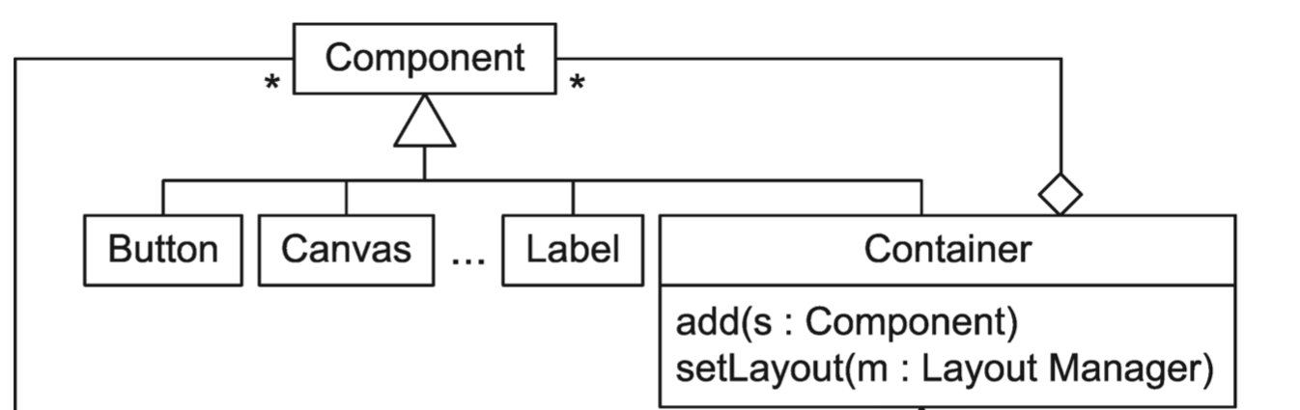
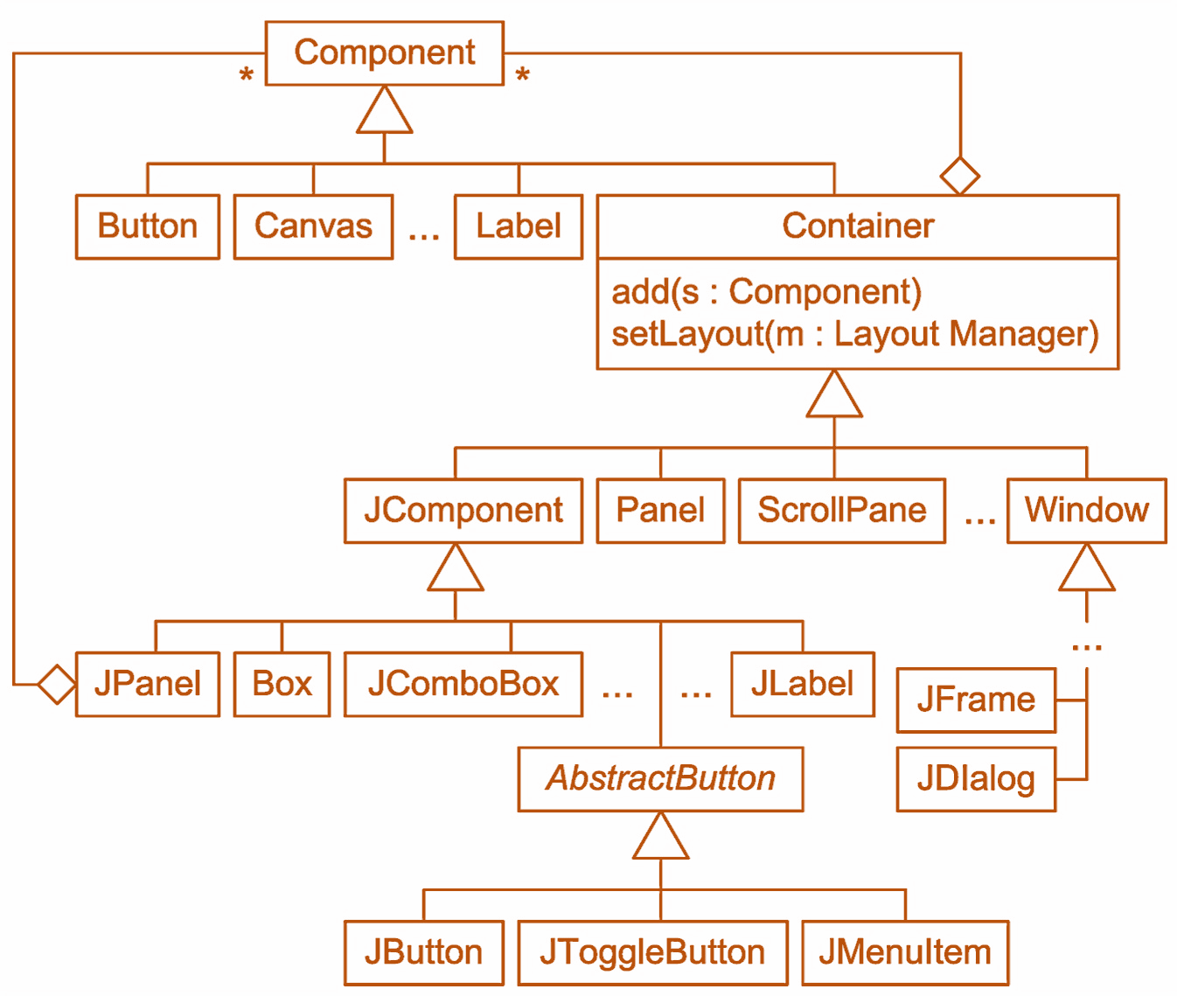
AWT vs. Swing
AWT – Abstract Window Toolkit
Swing – GUI Widget Toolkit

Slide 3
AWT vs. Swing (cont.)
AWT | Swing
Heavy-weight components | Light-weight components
Native look and feel | Pluggable look and feel
Does not have MVC | Supports MVC
Not available in AWT | With advanced features like JTable, JTabbedPane
Components are platform dependent | Components are platform independent
Requires java.awt package | Requires javax.swing package
Slower | Faster than AWT

Slide 4
An Introduction
By the end of this class, you should know how to…
Create a window with menus
Use different layouts
Use action listeners

Slide 5
Windowing

Slide 6
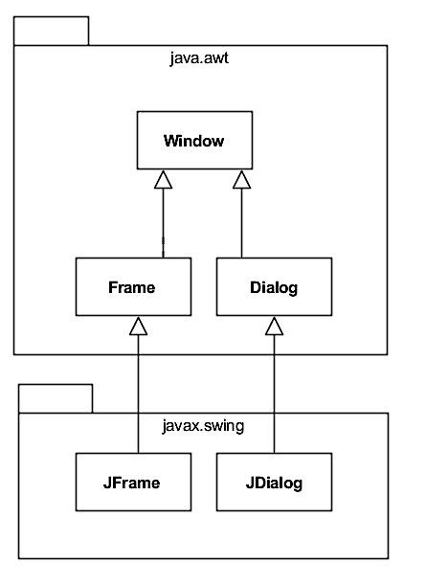
Windows in Java
Class Hierarchy

Slide 7
Windows in Java (cont.)
Window
show()
hide()
dispose()
Frame
getTitle(), setTitle()
getIconImage(), setIconImage()
isResizable(), setResizable()
isVisible(), setVisible()

Slide 8
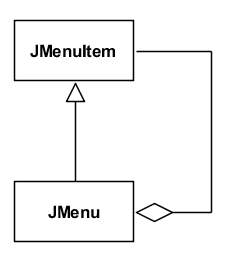
Menus
Using Something Like the Composite Pattern
An Example – MenuBarFrame.java

Slide 9
Dialog Boxes
Standard Types:
Message Dialog
Option Dialog
Input Dialog
File Dialog
Color Dialog
Examples
MessageDialogDriver.java
OptionDialogDriver.java
InputDialogDriver.java
FileDialogDriver.java
ColorDialogDriver.java

Slide 10
GUI Layout

Slide 11
GUI Layout
Organizing GUI components
Grouping GUI components
Positioning GUI components

Slide 12
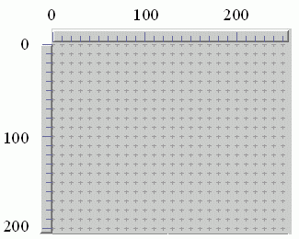
Absolute Layout
The "Graph Paper" Approach
An example – NullLayoutFrame.java

Slide 13
Relative Layout
Defined:
Components are positioned relative to each other, rather than an absolute position
Pros and Cons:
Better than absolute layout across platforms
Can be fairly inflexible
Example – FlowLayoutFrame.java

Slide 14
Template Layout
Defined:
Divide the container into sections and place one component in each section
Pros and Cons:
Easy to use
The right template may not exist
Example – GridLayoutFrame.java

Slide 15
Template Layout in Java (cont.)
Using BoxLayout
One row or column only
Fillers:
Struts (one-dimensional, fixed-size)
Rigid Areas (two-dimensional, fixed-size)
Glue (one-dimensional, variable-size)
Example – BoxLayoutFrame.java

Slide 16
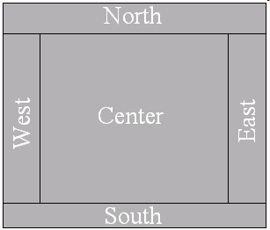
Template Layout in Java (cont.)
Using BorderLayout
Example – BorderLayoutFrame.java

Slide 17
Event-Driven Programming in GUIs

Slide 18
Overview
Traditional Programs:
Start at the first line and proceed step-by-step
Event-Driven Programs:
Some objects generate events and other objects respond to them

Slide 19
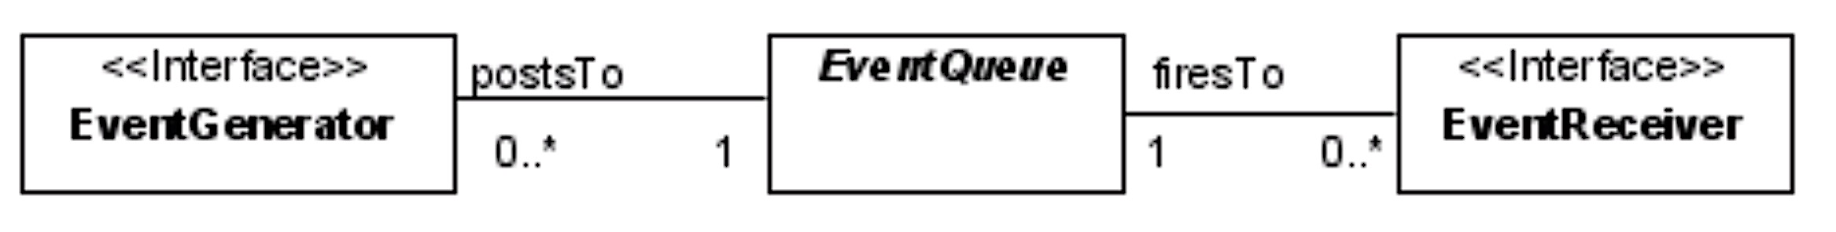
The Focus of Event-Driven Design
The events that can occur (e.g., mouse clicks, timing signals, key presses)
The classes that can generate events of different kinds (often called event generators)
The classes that need to respond to events of different kinds (often called event receivers)

Slide 20
The Event Queue
Responsibility:
A central repository of events that ensures that everything happens in the right order
Other Participants:
Event generators add events to the back of the queue (a process known as posting)
Event receivers are sent events as they are removed from the front of the queue (a process that is known as firing or dispatching)

Slide 21
Threads
The Event Dispatch Thread:
Events are dispatched in a single thread called the event dispatch thread
The SwingUtilities class has invokeAndWait() and invokeLater() methods that can be used to execute code in the event thread if necessary
Using Other Threads:
A SwingWorker object can be used to execute code out of the event thread if necessary

Slide 22
Using a JButton
Implement ActionListener
Handle the event in the actionPerformed() method
Example – ButtonFrame.java

Slide 23
Using a JCheckBox
One Way:
It extends JToggleButton
So, it behaves like a Jbutton
Another Way:
Implement ItemListener
Example – CheckBoxFrame.java

Slide 24
Using a JRadioButton
Use the same model as buttons
Are grouped using ButtonGroup
Example – RadioButtonFrame.java

Slide 25
Event-Driven Programming in GUIs (cont.)

Slide 26
Using a Text Component
Kinds:
JTextField
JTextArea
ActionEvents:
ActionEvent is generated when [Enter] is pressed
DocumentEvents:
Most applications only need to respond to changes in the contents of the model
The model is a Document
So, the important interface is DocumentListener
Example – TextFieldFrame.java

Slide 27
Using a JList
Some Issues:
Doesn't support scrolling directly (more on this later)
Interval selection is supported by the DefaultListSelectionModel
Handling Events:
Implement ListSelectionListener
Example – ListFrame.java

Slide 28
Using a JComboBox
A combination of a JTextField and a Jlist
So, implement either ItemListener or ActionListener (or both)
Example – ComboBoxFrame.java

Slide 29
Responding to JSlider Objects
The Event(s):
ChangeEvent
The Interface(s):
ChangeListener
The Method(s)/Message(s):
void stateChanged(ChangeEvent event)
Example – SliderFrame.java

Slide 30
Advanced GUI Layout

Slide 31
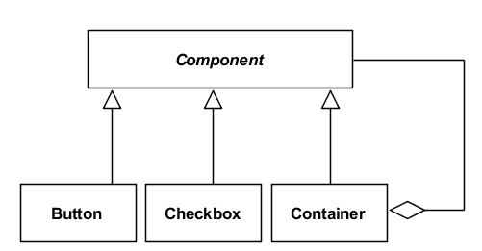
Hierarchical Template Layout
Overview:
Subdivide the sections in a template layout
Pros and Cons:
Platform independent and flexible
Difficult to get used to
Using the Composite Pattern
Example: HierarchicalLayoutFrame.java

Slide 32
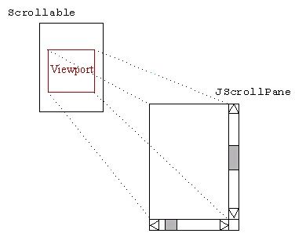
Scrollable Components
The Idea:
Use a "viewport" to make only a portion of their total area visible at a time
Enable the visible portion to change (i.e., appear to scroll)
In Java:
The Scrollable interface
A JScrollPane controls a Scrollable
Example: ScrollFrame.java

Slide 33



Docking Toolbars
The Concept:
A container that can be repositioned
In Java:
JToolBar
Some Views
Example: DockFrame.java

Slide 34
Borders
Motivation:
Visually group components (e.g., a group of RadioButton objects)
In Java:
A Border can be applied to any Jcomponent
Because a large number are used they should be created using a BorderFactory
Example: BorderExample.java

Slide 35
Layered Layout
Use the same "screen real estate" for multiple purposes
Put the different purposes on top of each other and provide a mechanism for moving between them
In Java use the JTabbedPane

Slide 36
Constrained Template Layout
The Idea:
Add constraints (e.g., doesn't expand) to sections of a template
In Java:
GridBagLayout

Slide 37
Serialization

Slide 38
Serialization
Defined:
The process of creating a "frozen" representation of a "live" (i.e., in-memory) object
Uses:
Copy objects
Provide persistence
Transport objects over a communications channel

Slide 39
Overview of Serialization in Java
The Serializable Interface:
Implemented by classes to indicate that their Objects can be serialized
Has no methods (serves only to identify the semantics of being serializable)
Serialization:
Handled by the writeObject() method in the ObjectOutputStream class
Deserialization:
Handled by the readObject() method in the ObjectInputStream class

Slide 40
The Serialization Process
An ObjectOutputStream maintains a mapping from instances and classes to handles.
When writeObject( ) is passed an instance that has not yet been written to the stream, the instance is assigned a reference handle, the handle is written to the stream, and the instance data is written to the stream.
When writeObject() is called with an argument that has already been written to the stream, the handle is written to the stream, and no further operations are necessary.
When an instance is being serialized and it contains another serializable instance, the serialization of the first instance is suspended and the second instance is serialized. After the second instance is fully serialized, the serialization of the first instance resumes.

Slide 41
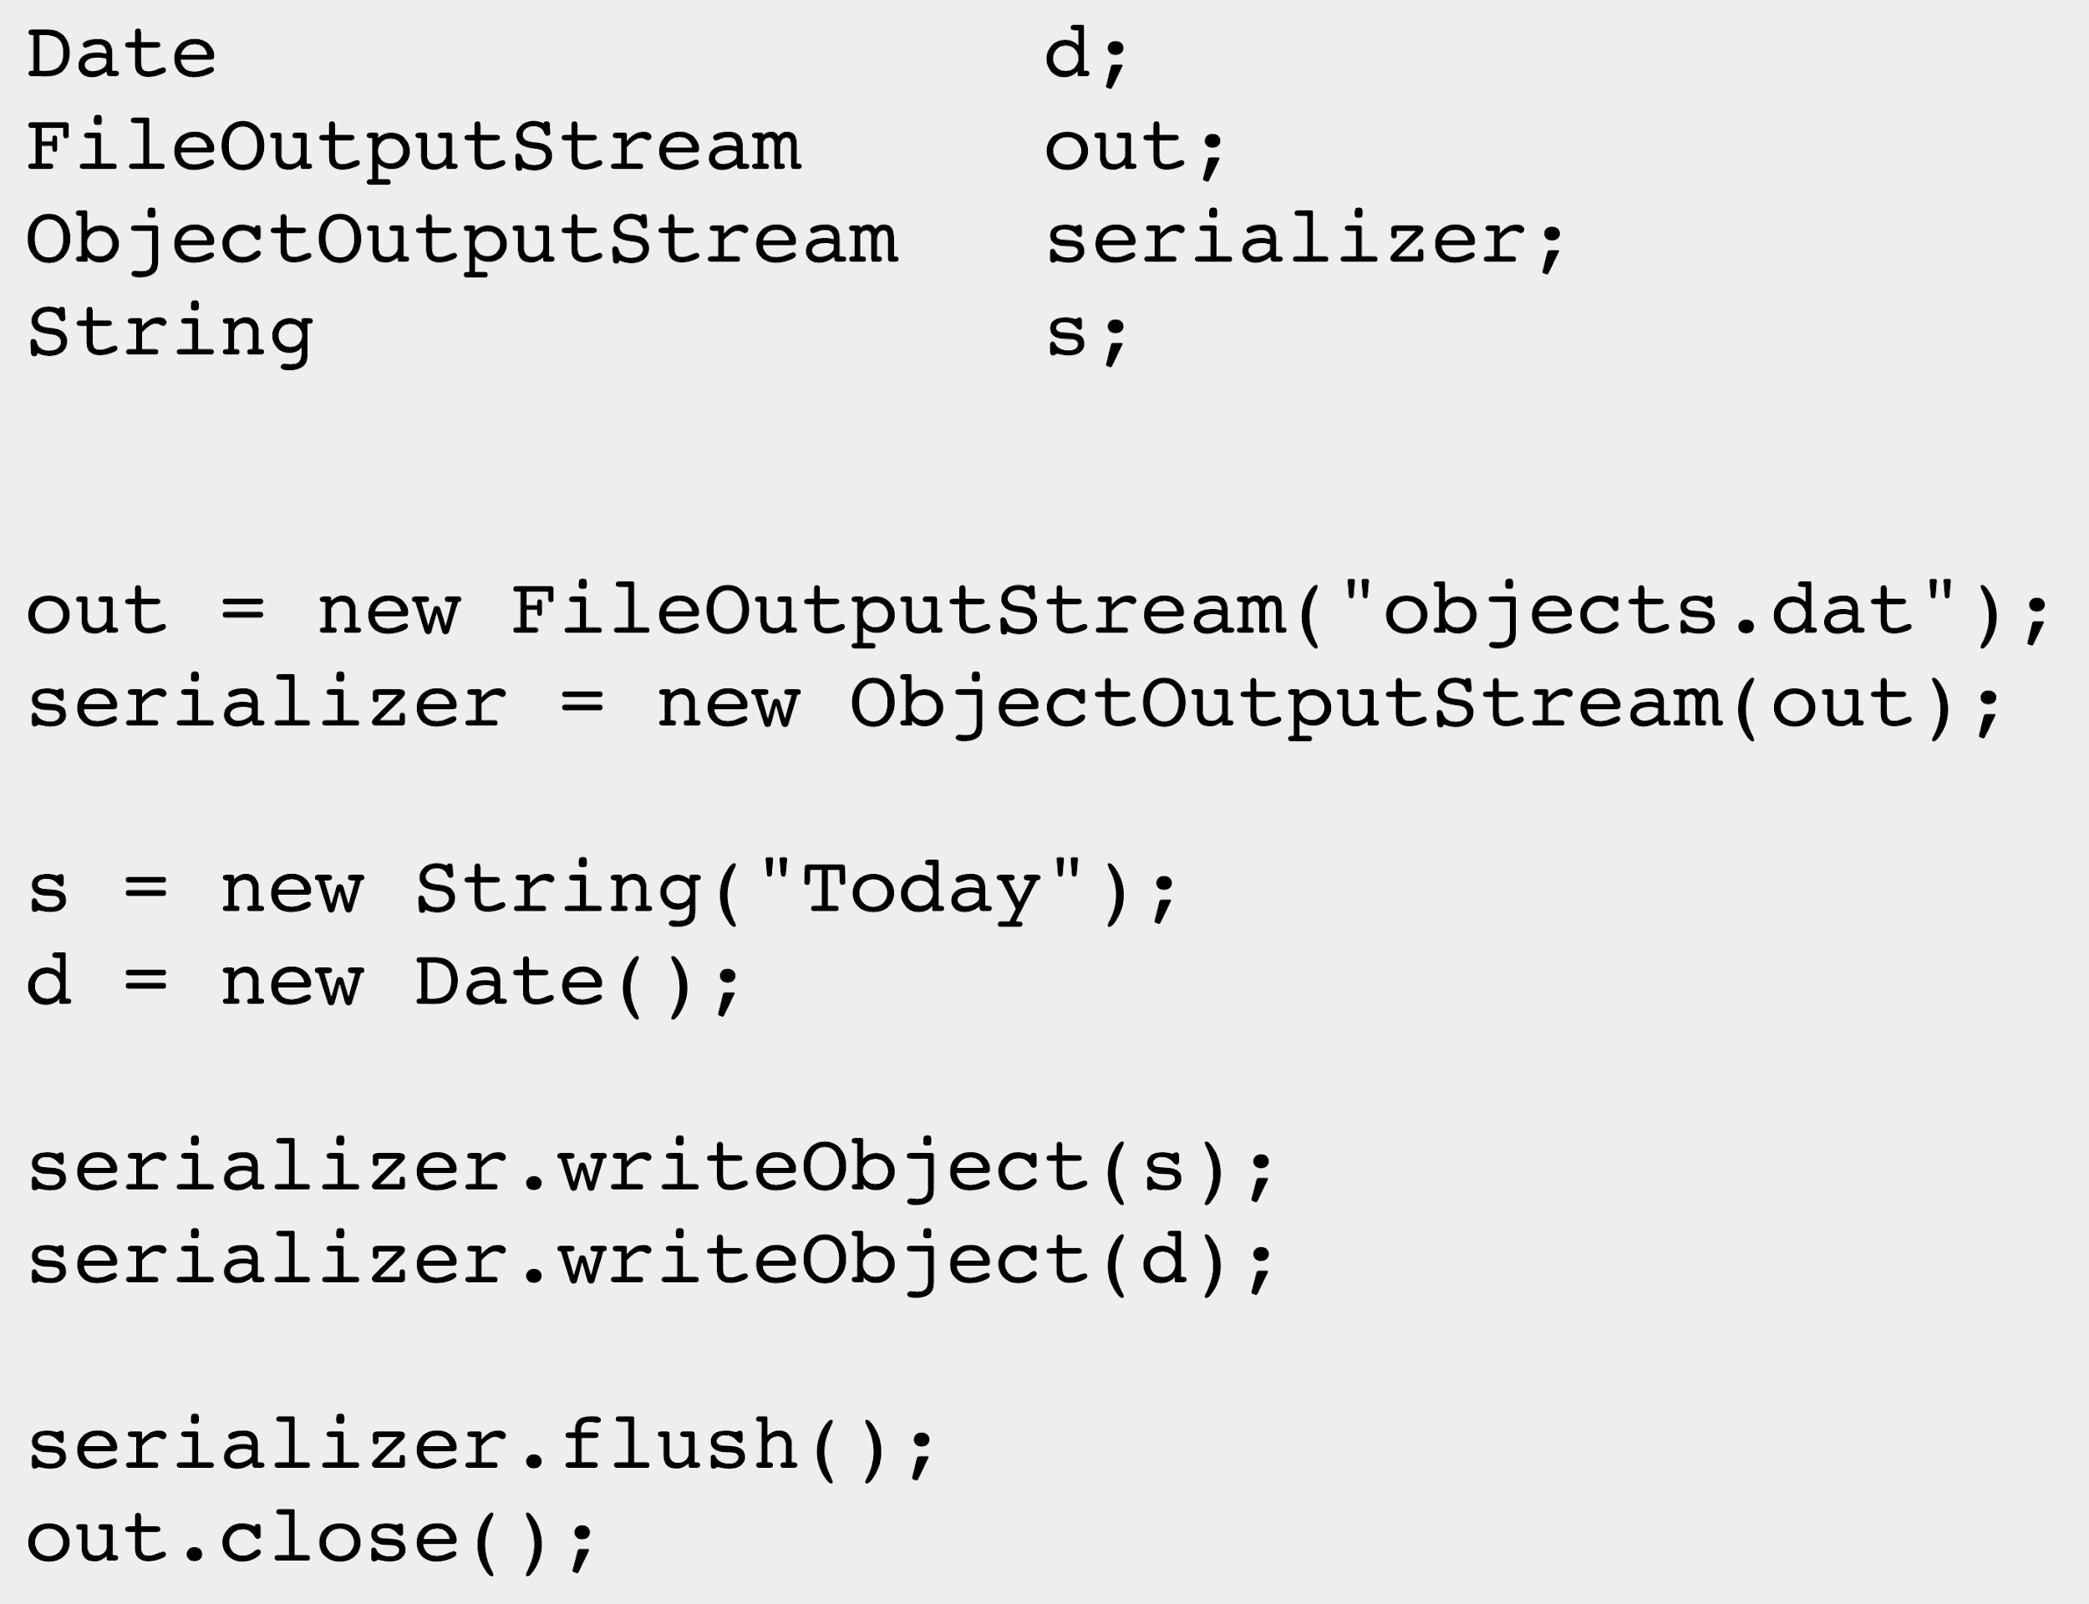
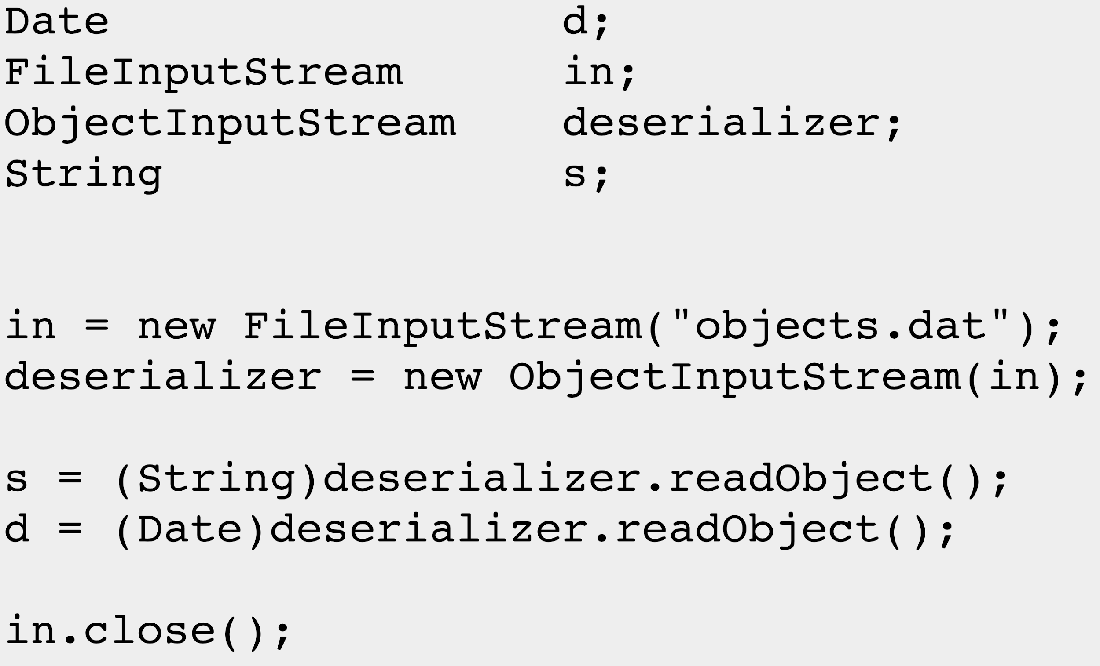
Examples

